Slide 1
How to Interpret Allan Deviation Graphs
Luke Unterman

Slide 2
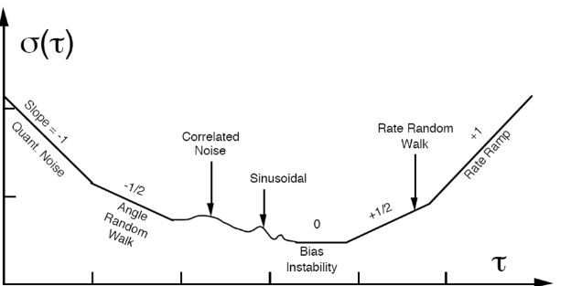
Example Log Allan Deviation Plot from IEEE-STD-952
Key Gyro Performance Factors:
Angle Random Walk
Bias Offset Error
Temperature/Vibration/Shock
Notes:
Angle Random Walk: Output of a gyro includes a broadband, random (white) noise element, and ARW describes the average deviation or error that occurs as a result of this noise element
Caused by silicon/quartz vibrating beam in a MEMS gyro
Describes short-term variation in input
Bias Instability: stability of bias offset (nonzero sensor input when the input is zero)
Gyro performance degrades over temperature, vibration, and shock
This is mainly what is used to derive performance specifications for all major gyro types (FOGs, MEMS, and RLGs)
Standard definition of bias instability is the minimum point on the allan variance curve
The lower the bias instability value, the better the performance
Critical in the gyro selection process
Rate Ramp:
It is slow monotonic change of output over a long time period
Rate Random Walk:
Long term changes to bias offset will be randomly distributed and may be permanent in nature. Even
though the drift of an individual sensor can not be predicted, the time scale over which the changes
occur can be defined by the RRW and introduces the opportunity to plan for recalibration in critical
applications that require extended life

Slide 3
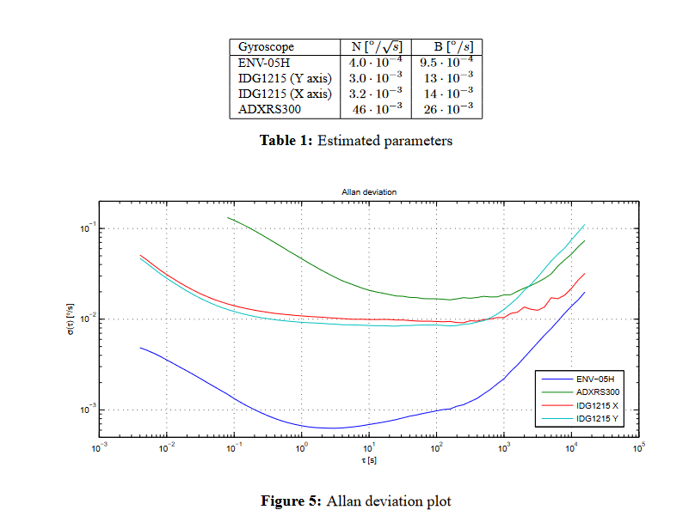
Performance Comparison of Different Gyroscopes
Best performing:
Blue (ENV-05H)
Why?
Lowest bias instability (9.5e-4)
Lowest angle random walk value (4e-4)

Slide 4
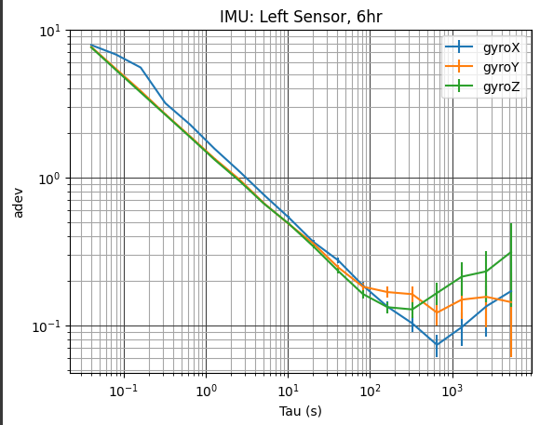
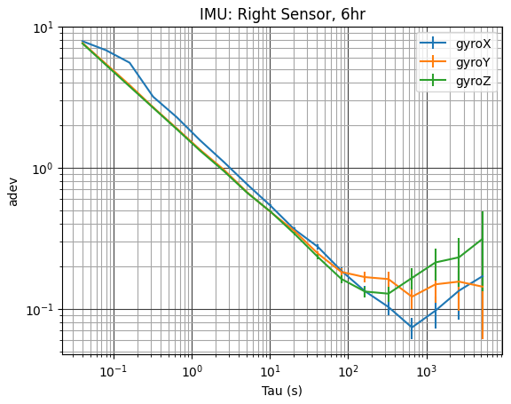
One IMU Allan Deviation Graph - From Testing
ARW
B.I.

Slide 5
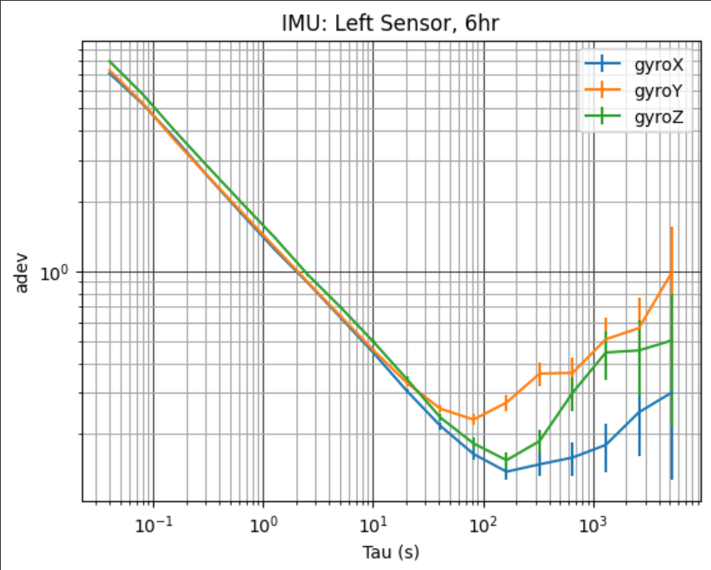
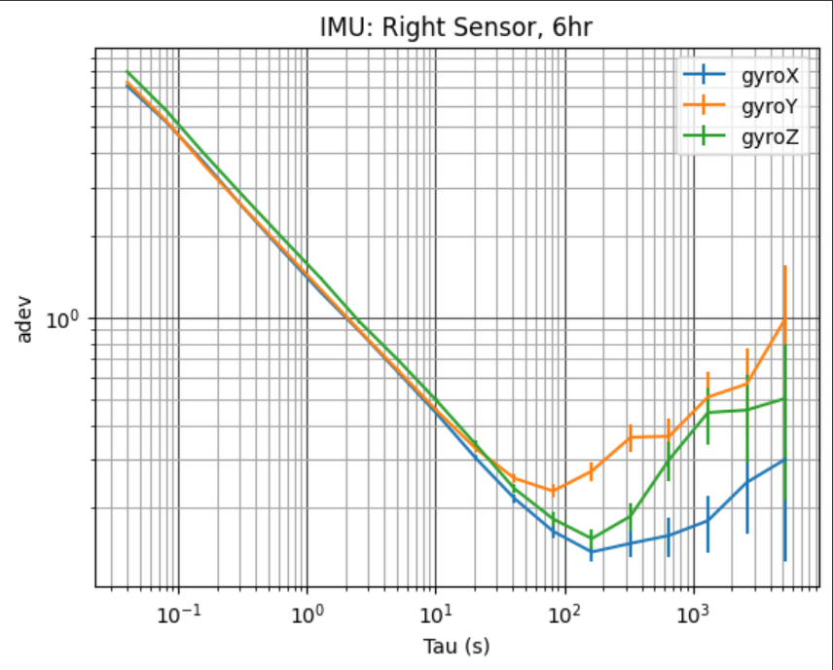
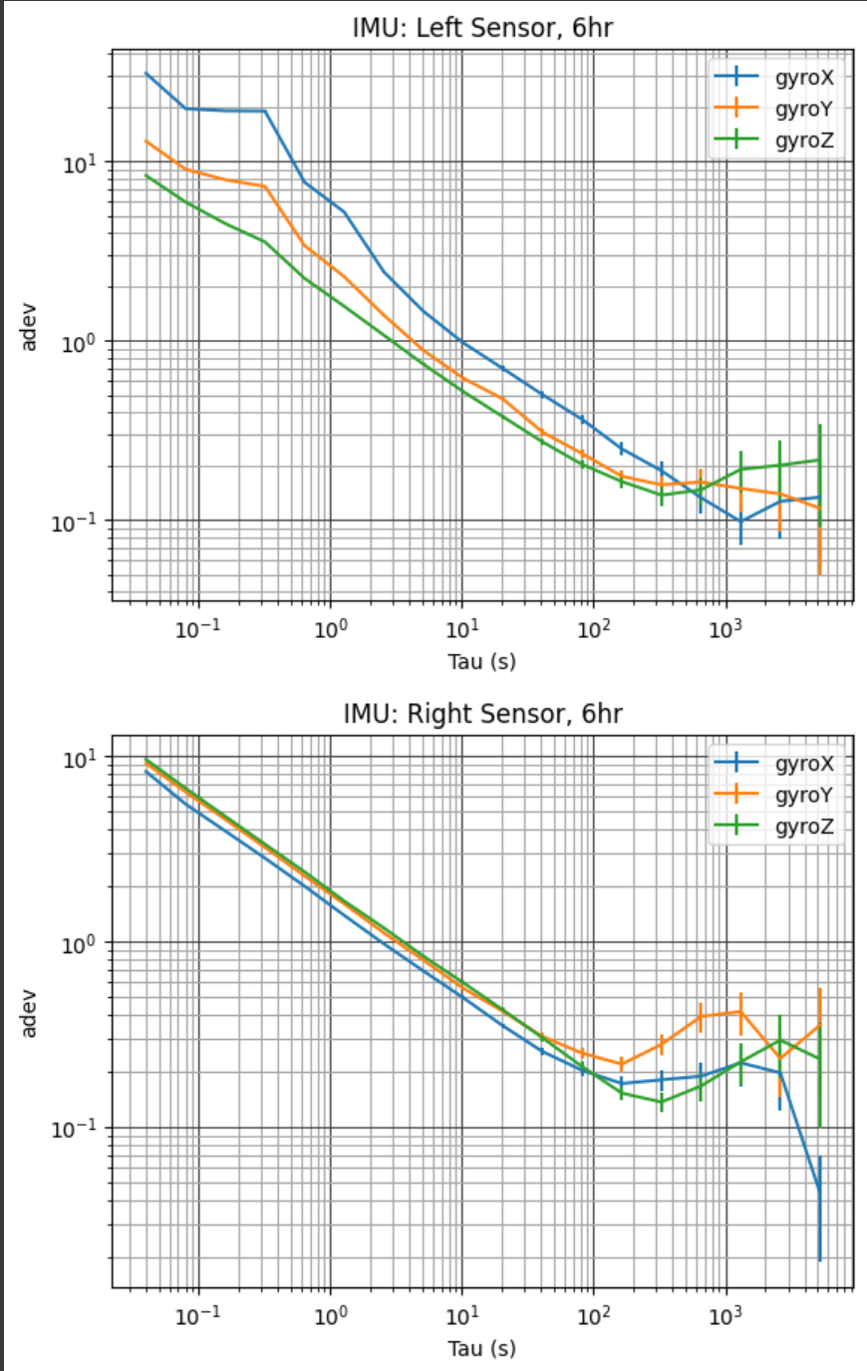
IMU Allan Deviation Graphs across 3 runs
Run 1:
Run 2:
Run 3:
Notes:
Allan variance gives the root mean square random drift error of the gyroscope as a function of the averaging time.
To calculate the Allan variance, we need to collect a large number of samples from the gyroscope when it is motionless. To accomplish this, let's assume that we have a dataset of N samples from the gyroscope output Ω(t) at multiples of the sampling time t₀. With the non-overlapping Allan variance technique, these N samples are divided into K disjoint groups of equal length where each group (or cluster) has N samples. If the sampling time is t₀, the total time duration of each group is T = nt₀.

Slide 6
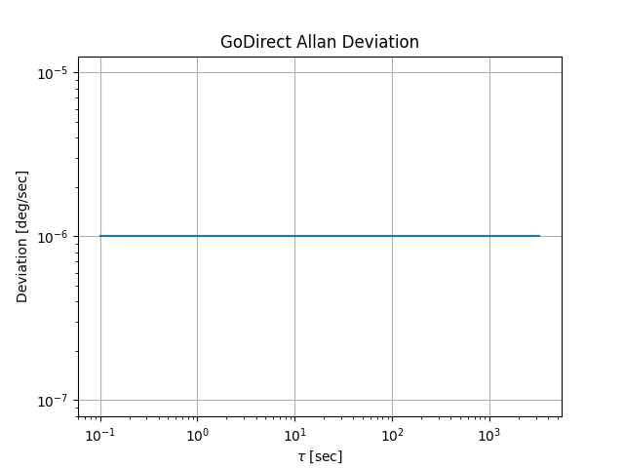
GoDirect Allan Deviation Graphs across 3 runs
No perceptible error/drift, added on small offset value in case there were 0 nonzero values (log plot)

Slide 7
